Slide 1


Wildfire Preparedness
Staff & Parent Presentation
Fall 2024
Kim Giuliacci, Division Chief/Fire Marshal
Selena Brown, WFPD Public Education Officer/ Emergency Preparedness Coordinator
Roberta Zarea, PVSD Superintendent
Notes:
Roberta

Slide 2

Presentation Agenda
SMCOE Big 5 Immediate Action Response Protocols (Evacuation)
PVSD Wildfire Emergency Response Plan
Evacuations, Closures, Shelter in Place
Student Release Process
Decision Checklist for School Closure
Wildfire Risk Reduction
Communication and Maintaining Situational Awareness
Poor Air Quality & High Heat Guidance Protocol
Discussion
Notes:
Roberta

Slide 3
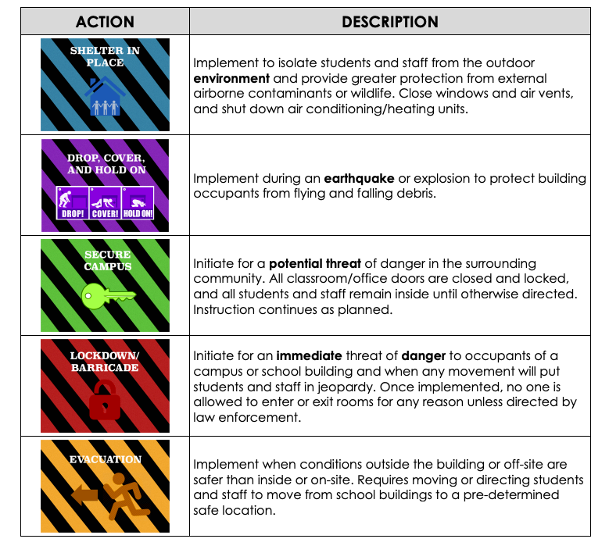

Immediate Action Response: The Big 5 Protocol
Possible Action During Wildfire
Big 5 Community Packet
Notes:
Roberta

Slide 4
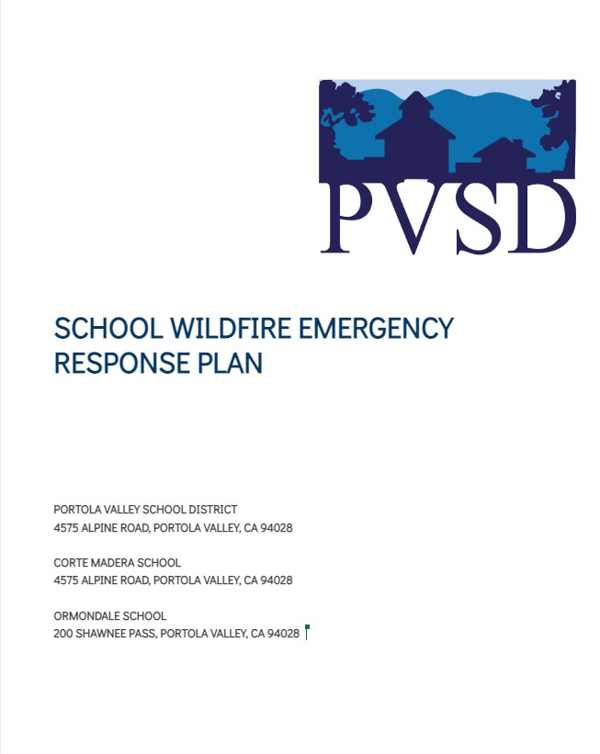
PVSD Wildfire Emergency Response Plan
The purpose of this plan is to provide for the orderly and coordinated evacuation of PVSD facilities once it is determined that such action is the most effective means available for protecting students and staff from the effects of an emergency situation.
WILDFIRE EMERGENCY GUIDANCE TABLE
WILDFIRE EMERGENCY DECISION TREE
CAMPUS OVERVIEW AND MAPS
SCHOOL OVERVIEW
TRANSPORTATION OVERVIEW
OFF SITE EMERGENCY EVACUATION PLAN
CONTROLLED DISMISSAL & REUNIFICATION PLAN
SHELTER-IN-PLACE PROCEDURES
SITUATIONAL AWARENESS RESOURCES
EMERGENCY COMMUNICATIONS PLAN
EMERGENCY CONTACT LIST
Internal Document
Notes:
Roberta

Slide 5
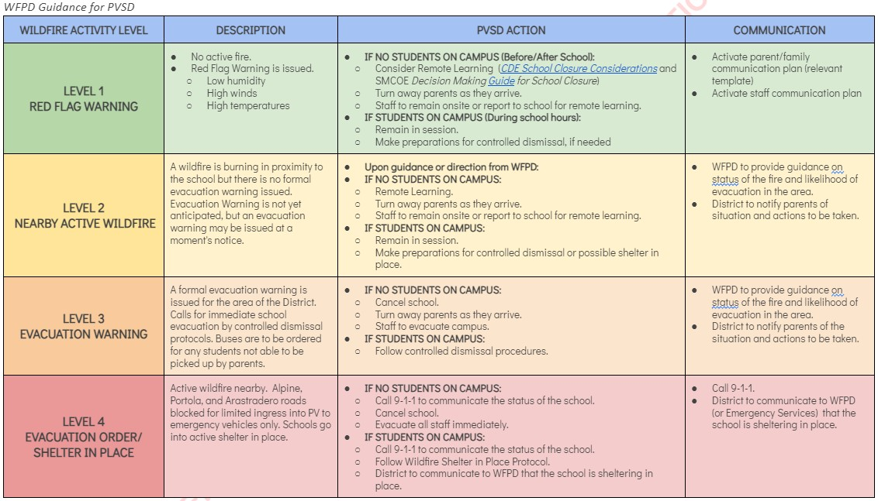
PVSD Wildfire Emergency Guidance Table
Notes:
Kim/Selena
Roberta

Slide 6
Evacuation,
Closure,
Shelter-in-Place,
Student Release

Slide 7
Evacuation Terminology
In an emergency, local officials may issue either an evacuation warning or an evacuation order.
Evacuation Warning (prepare to evacuate):
Alerts people in an affected area of potential threat to life and property.
Considers the probability that an area will be affected within a given timeframe, and prepares people for a potential evacuation order.
Is particularly necessary when dealing with a variety of issues such as large school populations.
In a fast-moving fire there may not be time for first responders to issue an evacuation warning (prepare to evacuate).
Evacuation Order:
Requires immediate movement of people out of an affected area due to an imminent threat to life.
Notes:
Kim and/or Selena

Slide 8

What is a Red Flag Warning?
Issued by the National Weather Service when weather conditions are right for extreme wildfire events
Sustained or gusty winds, and hot and dry conditions, that make wildfires more likely to ignite and spread rapidly.
The combination of gusty winds and low humidity can cause fire to rapidly grow in size and intensity.
CA Fire Weather
Woodside Fire
Woodside Fire Protection District website
Prepare for evacuation, if needed.
Maintain high alert.
Notes:
Kim, Selena

Slide 9
Voluntary Evacuation/Unplanned Controlled Dismissal
To best ensure the safety of staff and students, school administrators will work in conjunction with local fire and law enforcement to evaluate situations that arise relative to a school site’s unique characteristics, such as transportation dependencies, ingress and egress options and capacity, level of defensible space around its structures, and surrounding topography.
Depending on the circumstances, it may be best to issue an early dismissal and voluntarily evacuation.
Parents/Guardians will be notified via ParentSquare Urgent Alert.
Notes:
Roberta

Slide 10
Precautionary Closure
To best ensure the safety of staff and students, school administrators will work in conjunction with local fire and law enforcement to evaluate situations that arise relative to a school site’s unique characteristics, such as transportation dependencies, ingress and egress options and capacity, level of defensible space around its structures, and surrounding topography.
The decision to close or cancel school is based on many considerations, the most important of which is the safety of students, staff, parents, and others in the community. (See Decision Tree - slide 16)
Parents/Guardians will be notified via ParentSquare Urgent Alert.
Notes:
Roberta

Slide 11
Shelter in Place (During Fast Approaching Wildfire)*
Sheltering in place is an emergency-driven alternative which is seldom under the best of circumstances, but must be considered when evacuation of the site is not an option.
This may be the most appropriate protective action during a fast moving, approaching wildfire, when leaving school grounds poses more of a danger than remaining in place.
When an evacuation may put students and staff at greater risk, it may be necessary to Shelter-in-Place.
Designated Shelter-in-Place locations at each school are the Multi-Use Rooms.
* WFPD Mandated Shelter-in-Place, not to be confused with Big 5 Shelter in Place for environmental issues.
Notes:
Kim/Selena
Under the best circumstances, sheltering‐in-place should be considered when one or more buildings on campus is designed to withstand heat and flames from an approaching wildfire. In other words, these buildings must be built with ignition-resistant construction, including well maintained defensible space, such as fire-resistant landscaping, with a minimum 100‐foot defensible space surrounding the structure(s). Woodside Fire Protection District has assisted in evaluating our defensible spaces, ignition-resistant construction, and fire mitigation efforts.

Slide 12
Transportation & Off-Site Evacuation
The District works with the Town of Portola Valley, the San Mateo County Department of Emergency Management (DEM), and Woodside Fire (WFPD) to explore options to set up transportation and establish off-site assembly locations in an emergency situation.
Transportation options for all students/staff are dependent upon the situation.
Off-site assembly locations are dependent on the situation.
Notes:
Roberta
What scenarios will district reach out to access buses, what window of time?
How will this be communicated?
Possible emergency transportation resources (buses would need to come to the schools as we don’t own buses):
Las Lomitas Elementary School District
Sequoia Union High School District
SamTrans

Slide 13
Student Release Process
An On-Site Student Release may occur for incidents small enough to render the school building unsafe after an EVACUATION, but does not require students to be relocated to the Off-Site Evacuation Location.
An Off-Site Student Release may occur for incidents where the school site is deemed unsafe or following an EVACUATION to the Off-Site Evacuation Location as required by law enforcement.
Parents/Guardians will be notified via ParentSquare Urgent Alert.
Person picking up student(s) must be listed on the Emergency Contact Form as someone authorized to pick student/s up, no exceptions
Parents/guardians may not pick up other students for whom they are not an Emergency Contact, no exceptions
Valid Form of ID will be required to verify identity, no exceptions
Bring ample patience, understanding, and cooperation
Notes:
Roberta

Slide 14
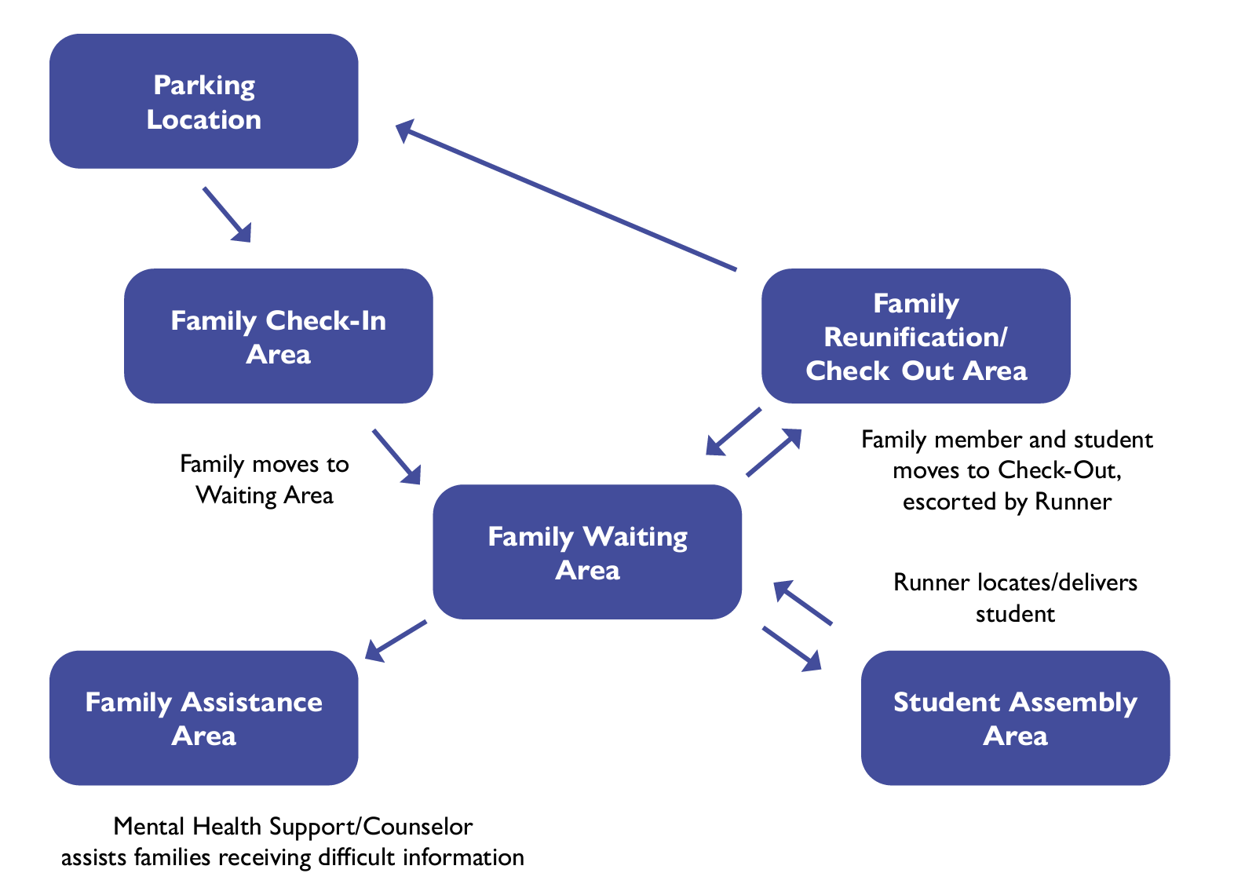
Student Release Process Example: Schools will provide specific step-by-step instructions
Notes:
Roberta

Slide 15
Decision Checklist for School Closure

Slide 16
PVSD Wildfire Emergency Guidance Table
Notes:
Kim/Selena

Slide 17
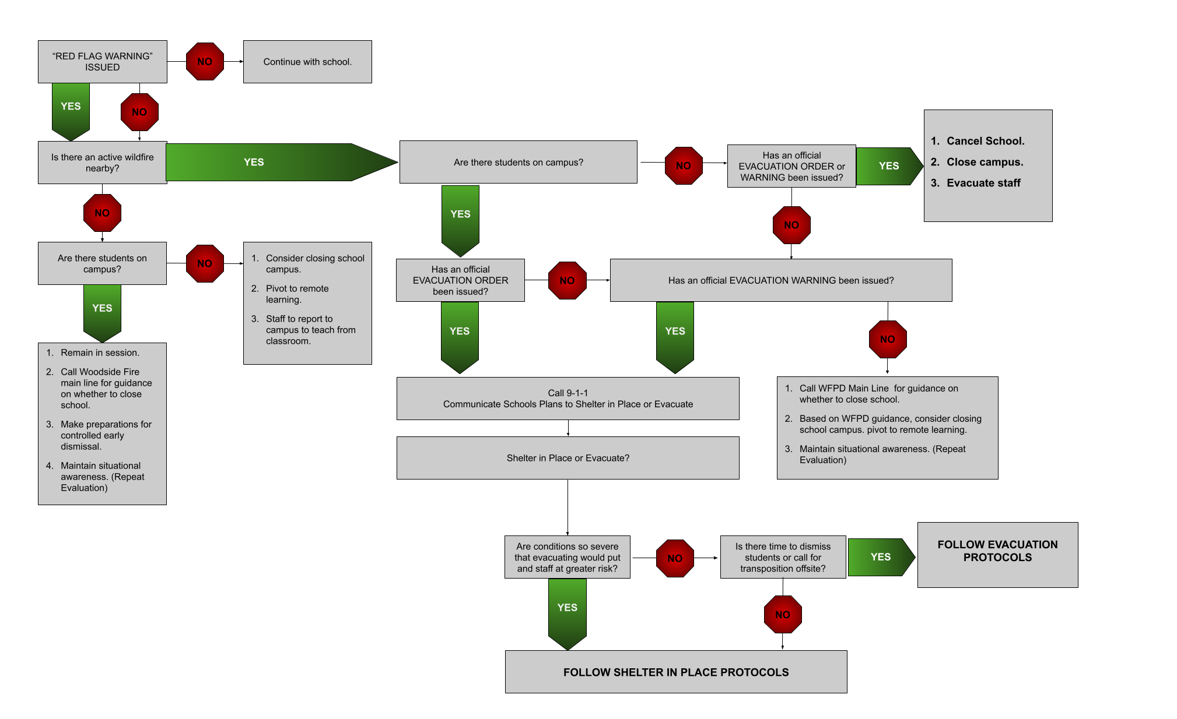
Wildfire Emergency Decision Support Tree
Notes:
Roberta, Kim/Selena

Slide 18
Decision Making Checklist for School Closure
Checklist to determine whether school/district meet requirements to stay open during power outage, weather event, or other unusual circumstances, in collaboration with SMC Sheriff and WFPD:
Safety & Operations: access to school site, ability to evacuate, adequate supervision, natural light or lanterns, communication systems, etc.
Health: water, ventilation, temperature, toilets, etc.
Instruction: working technology or tech-free instruction, sufficient substitutes if needed
Equity Considerations: families with limited financial resources may not have options for alternate child care, working parents/guardians are disproportionately affected
Communication: monitor communications from SMCOE and emergency preparedness partners, balance desire to provide parents/guardians sufficient notice of school closure with potential of cancelling school prematurely, plan to communicate with parents/guardians and employees, encourage families to create contingency plans
Notes:
Roberta

Slide 19
PVSD’s Risk Reduction

Slide 20
Wildfire Risk Reduction in PVSD
The buildings at each site are generally protected from wildfire risk and are locations for shelter in place protocol:
Ormondale and Corte Madera modernized buildings consist of fiber cement siding and fiber cement panels with gypsum sheathing, which are non-combustible.
Ventilation systems are equipped with screen mesh that reduce the possibility of embers entering combustible spaces. Vents can be closed remotely to prevent outside air from entering the building. The systems are also tied into the fire alarm/notification system.
Roofing at each site are adequately rated roofing systems by the National Fire Protection Agency (NFPA) and UL (Underwriters Laboratories).
New buildings are fully compliant with building code Chapter 7A (formerly called the “Wildland/Urban Interface”), which is intended to govern high-fire-danger areas. Building materials are non-combustible. The majority of visible wood is fire-resistance treated, the siding is non-combustible, the roofs are non-combustible, gutters and attic vents are protected as required, and the glass is tempered as required.
The buildings were not intended to be shelters such as essential services buildings, but they are designed to resist ignition and propagation as code requires.
Notes:
Roberta

Slide 21
Wildfire Risk Reduction in PVSD
Defensible space surrounds each of the campuses, and the District continues to clear unnecessary/unwanted vegetation throughout the campuses.
The District will continue to repair damaged vent screens and add screens as necessary, repair damaged siding and roofing as well as keep brush and unwanted vegetation to a minimum throughout the campuses.
The District hired an arborist to do a risk assessment report on trees at Corte Madera and Ormondale.
The District has contracted with contractors to perform removal of high risk trees and full pruning on all trees at both sites. This has been put on the calendar to be done routinely as well as routine weed abatement.
Notes:
Roberta

Slide 22
Communication and
Situational Awareness

Slide 23








Maintaining Situational Awareness (live links)
Portola Valley Radio 1680 AM
Tune to radio or stream via internet
Notes:
Selena

Slide 24
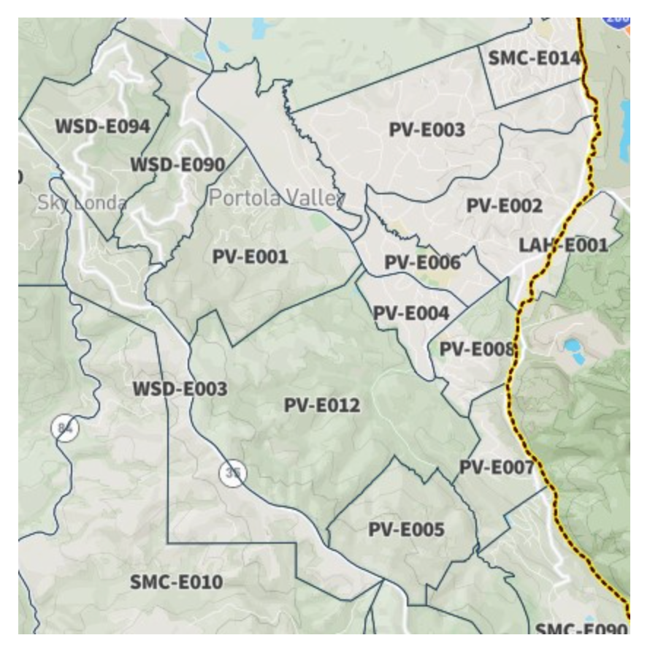


SMC Alerts & Genasys
Evacuation notices are issued through SMC Alert
Genasys Protect: uses your location on the website and in the app to offer you the most relevant information in an emergency situation (replaces ZoneHaven). Download the app on your iphone NOW!
Notes:
Selena

Slide 25
Emergency Communications and Maintaining Situational Awareness
Internal (within District):
Public Announcement system*
Cell and texting
Fire Alarm System All Call
Two-way radios (walkie-talkies) for each classroom
Shortwave radios
Landline telephones
* only if there is electrical power
External (District to parents):
Parent Square Urgent Alert text, email, voice mail - pulls info from PowerSchool
PVSD website
Social Media (Instagram, Facebook)
PV Forum and PV NextDoor
Town of PV Radio 1680
SM County Office of Education website
Portola Valley Town website
SMC Alert
Town of PV radio communication EPC
Notes:
Roberta

Slide 26
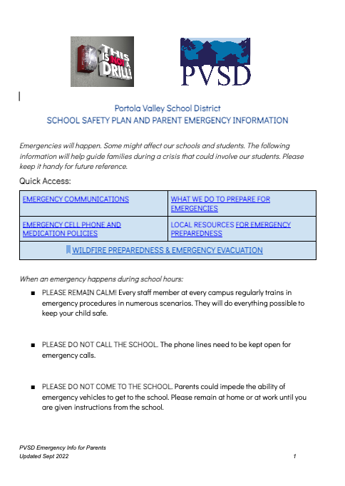

Emergency Parent Information
Link to School Safety Plan and Parent Emergency Information (Scan QR Code for Access)
Located on PVSD website (pvsd.net) homepage
Notes:
Roberta

Slide 27
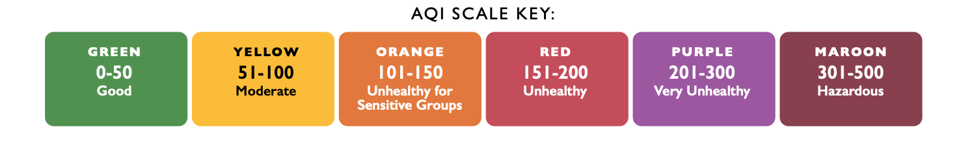
Poor Air Quality &
High Heat Guidance

Slide 28
Poor Air Quality: PVSD adheres to SMCOE’s Guidelines
Keep Track of Air Quality: SMCOE and the San Mateo County Health Department use official BAAQMD and AirNow sites to track data and make decisions.
Adjust Activity Based on Air Quality
School Air Quality Activity Recommendations (see Slide 24): how PVSD addresses differing levels of air quality.
Sensitive Groups: Children with certain medical conditions may be impacted by air quality in the moderate (yellow – 51-100) and unhealthy for sensitive groups (orange – 101-150) levels. Parents/guardians of these children should notify their schools.
School Response: When air quality dips to unhealthy levels (red – 151-200), PVSD practices the Big Five Shelter in Place protocol (keeping all activities indoors, limiting physical activity, and minimizing the opening and closing of doors), and continue regular classroom instruction.
Schools are the best place for students to be when air quality is poor as they are well supervised, can be kept indoors, and are able to continue to learn.
If air quality becomes hazardous (maroon – 301-500) and schools do not have the ability to keep outdoor air from easily entering the school,then a school may decide to close.
Notes:
Roberta

Slide 29
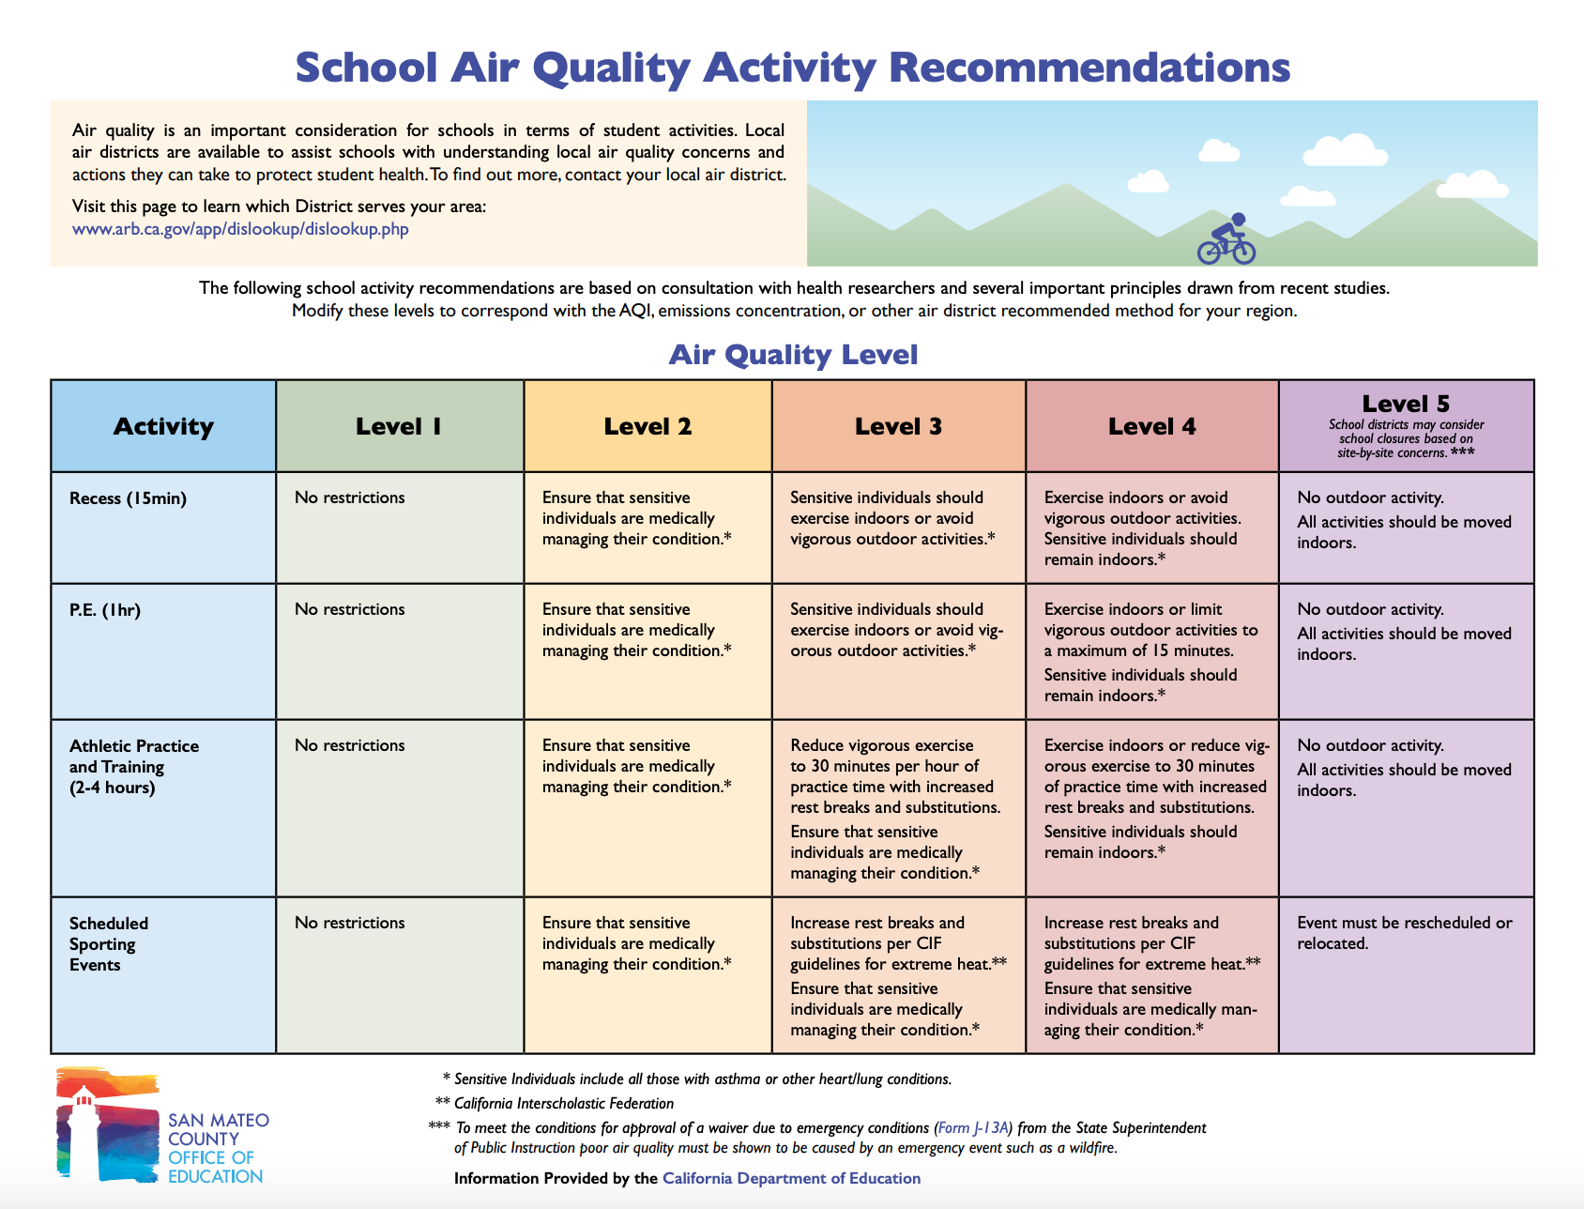
Notes:
Roberta

Slide 30
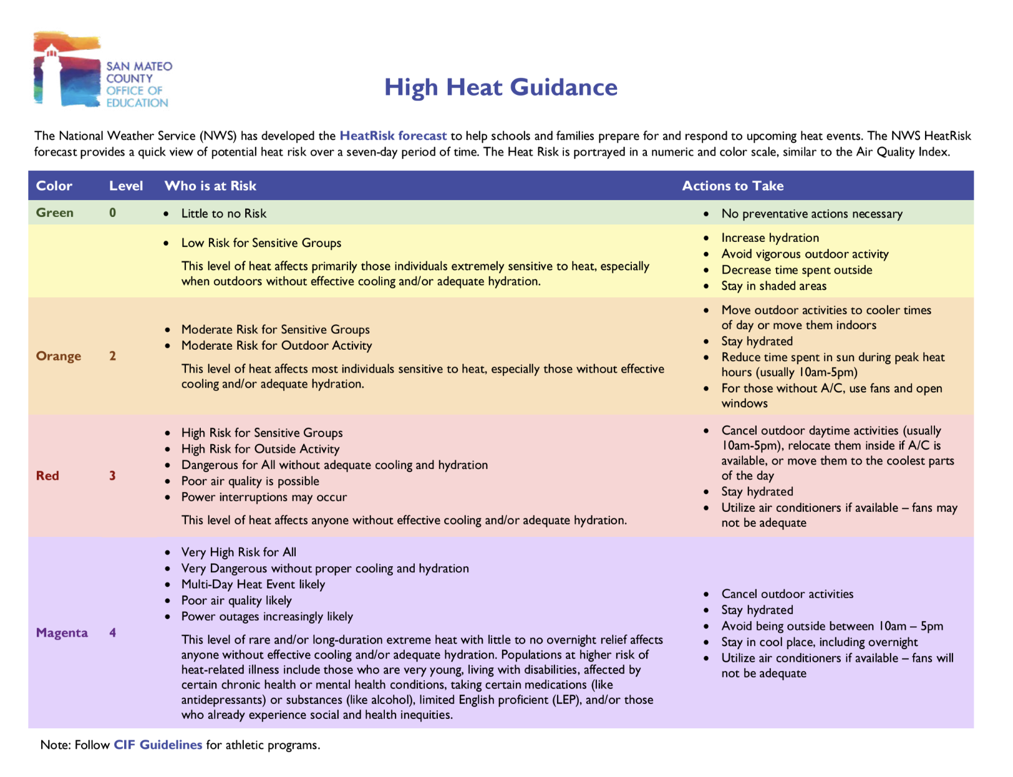
Notes:
Roberta

Slide 31
Discussion

